Slide 1
Introduction to CW
Harold Hallikainen, W6IWI

Slide 2
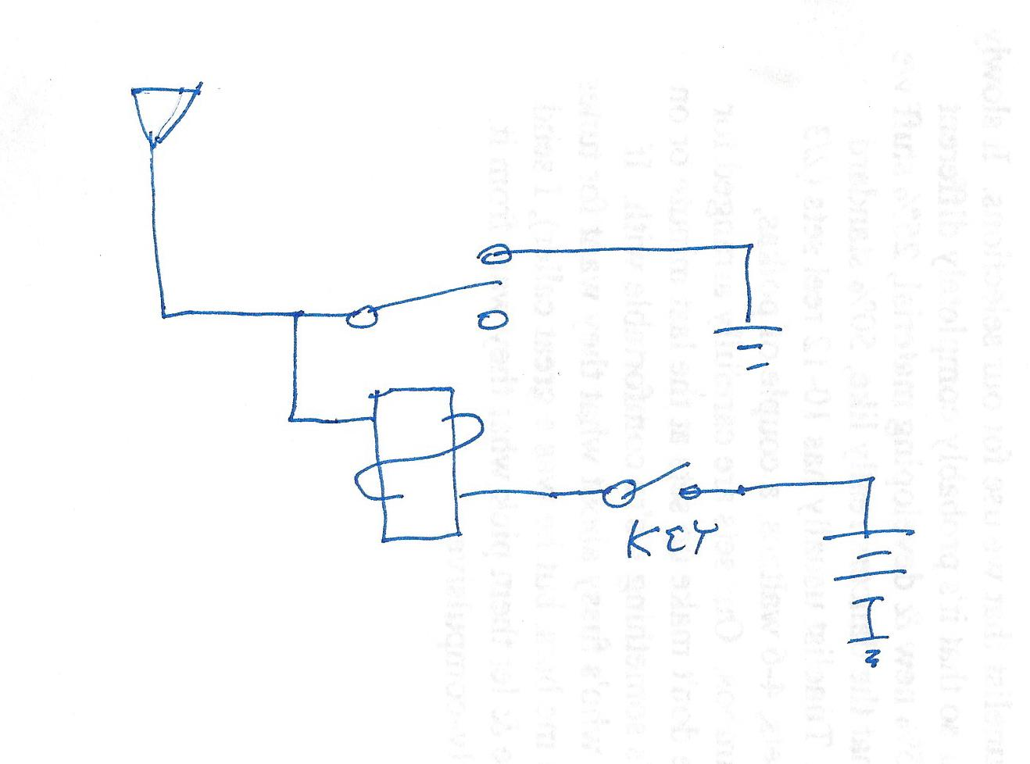
CW?
Continuous Wave – Prior to “continuous wave,” spark transmitters were used to send radiotelegraph.

Slide 3
“Morse” Code
Prior to the invention of the electromagnet in 1824, various optical signal systems were used for long distance communications including smoke signals, semaphore signals, etc.
A telegraph was patented in 1837.
A variety of codes were used before arriving at our current International Morse in 1865.

Slide 4
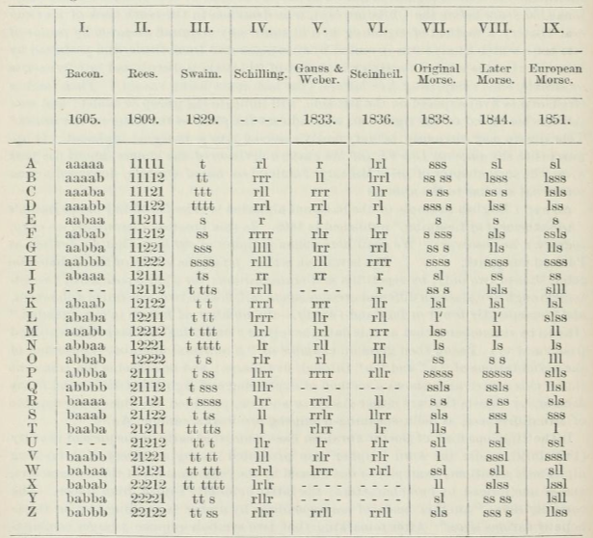
Codes Through the Ages
All are binary (or three state when including a lack of signal)
1605 code is 5 bit binary, similar to Baudot used in RTTY
1809 adds missing letters and reorders slightly.
1829 is a variable length code with gaps within characters. T is Tap, S is Scratch. It was used to communicate in prisons.
1836, 1833, and previous column, R and L indicate the movement of a galvanometer. This is the beginning of the electrical telegraph and polar signaling.
1838, Morse’s original code. Note gaps in some letters. S is “short” or “dit,” while L is “long” or dah. This is a change from the previous codes where the two states were indicated by polarity, now by signal duration.
1844, Morse’s revised code. This became American Morse or Railroad Morse and continued to be used by railroads.

Slide 5
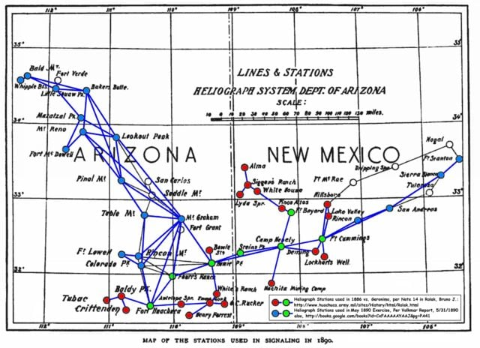
Arizona Heliograph Network (1890)

Slide 6
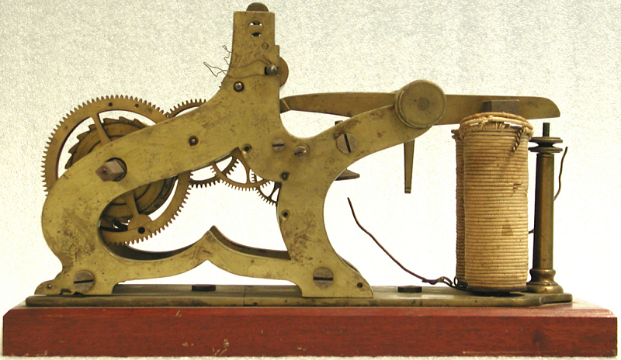
Morse’s Original Telegraph Register
Embossed dots and dashes into paper tape.

Slide 7
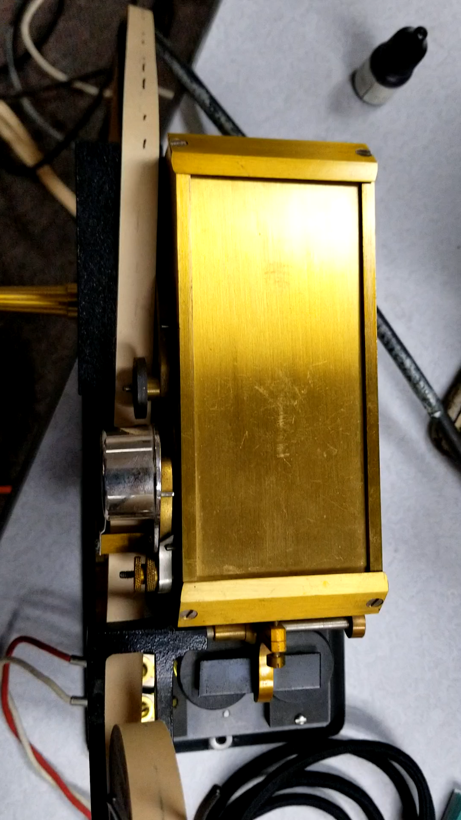
Pen Register

Slide 8
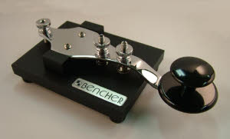
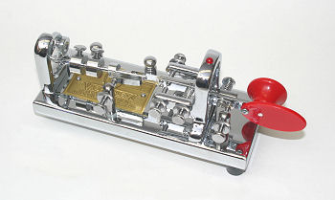
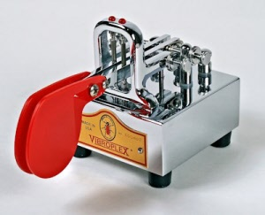
Keys
Straight Key – Operator responsible for all timing. Press four times for letter H
Bug or Semi-automatic key. Press to right to send series of dits. Press to left to send dah. Dits are timed by bug settings. Dahs are timed by operator.
Paddle drives electronic keyer. Press to right for series of dits. Press to left for series of dahs. If “iambic” squeeze for alternating dits and dahs.

Slide 9
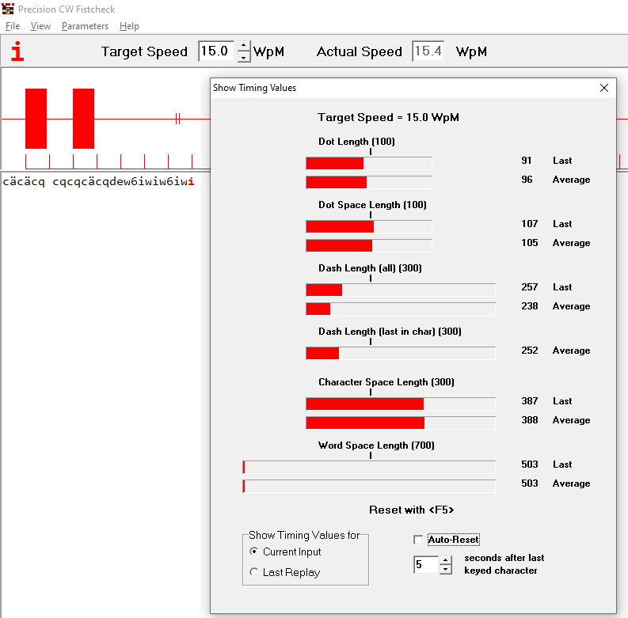
Ideal Timing
Dit – One DitTime
Space between dits – 1 DitTime
Dah – 3 DitTimes
Intercharacter Space – 3 DitTimes
Interword Space 7 DitTimes

Slide 10

Typical QSO

Slide 11
Resources
Precision CW Fist Check - https://www.qsl.net/dj7hs/download.htm
ARRL CW Practice - https://www.arrl.org/code-practice-files
EBOOK2CW - https://fkurz.net/ham/ebook2cw.html
Morsle - https://morsle.fun
Android Morse Code Reader - https://play.google.com/store/apps/details?id=org.jfedor.morsecode
KPH - https://www.radiomarine.org/

